Slide 1
CIS-591 Final Project- Team D6

Slide 2
Business Problem
Due to the occasional generation of inaccurate or nonsensical responses by the chat-GPT, our users are experiencing a suboptimal experience, resulting in decreased satisfaction and engagement with our platform. We need to improve the accuracy and reliability of our chat-GPT to ensure that it consistently generates high-quality responses to user prompts, ultimately enhancing the user experience and driving user engagement.

Slide 3
Who is OpenAI and what is chatGPT:
OpenAI's mission is to develop and promote friendly AI that benefits humanity as a whole. The organization conducts research in a range of AI fields, including natural language processing, robotics, and reinforcement learning.
ChatGPT is an AI language model created by OpenAI that generates natural language text in response to user prompts. It's trained on large amounts of text data and can produce contextually relevant responses for a variety of applications, including chatbots and language translation.

Slide 4


Vision
LDA & Sentiment Analysis
Model Deployment and Production
Data Collection
Data Cleaning
Evaluation

Slide 5
Data Description:
Dataset of 13K messages from open AI and ChatGPT subreddits curated for AI and NLP analysis.
Global dataset from 4/4/23 to 27/4/23 via PRAW code and Reddit API.
Collected only user-generated data with no private info.
Variables: MessageID, Timestamp, Author, ThreadID, Threadtitle, Message body, Reply to, Permalink.
High-quality data carefully curated for relevance.

Slide 6
Data Sources, Collection and Cleaning:
Data sources: The data was sourced from two platforms, Reddit and Twitter. Reddit is a social news and discussion website where registered members can submit content, including text posts and direct links. Twitter is a social media platform where users can post and interact with messages, known as tweets. Both platforms are widely used for discussions related to artificial intelligence and natural language processing.
Data Collection: The data was collected using API (Application Programming Interface) methodologies. APIs allow applications to communicate with different software components and retrieve data from various sources. This ensures that the data collected is accurate and complete.
Data Cleaning: Text processing algorithm: To improve data quality, a text processing algorithm was used to clean the data and remove any irrelevant noise. The algorithm identifies and removes irrelevant content, such as spam and unrelated posts, to ensure that only relevant messages were included.

Slide 7
Challenges Faced with Data:
Social media data from platforms like Reddit and Twitter can have noise and clutter due to the use of abbreviations, slang, and misspellings, making it difficult to accurately identify relevant data.
Another challenge with collecting data from social media platforms is the varying quality of the content. Some posts may be low-quality, contain irrelevant information or be outright spam.
Collecting data through APIs can have limitations such as rate limits or restricted access to certain types of data, which can affect the quality and quantity of data collected.
Preprocessing and cleaning the data can also be a time-consuming task, especially when dealing with a large amount of data.

Slide 8
LDA and Sentiment Analysis:
Latent Dirichlet Allocation (LDA) is a statistical model used to find topics in a collection of text. The model works by analysing the frequency of words across all documents and tries to group similar words together in different topics. LDA was run on subreddits: chatGPT and OpenAI.
Sentiment Analysis was conducted on subreddits to determine prevailing sentiments of various topics. Significant differences in sentiment were found among certain topics. Analysis of bigrams revealed that ChatGPT's output generated strong positive sentiment, whereas its actions were met with strong negative sentiment.

Slide 9
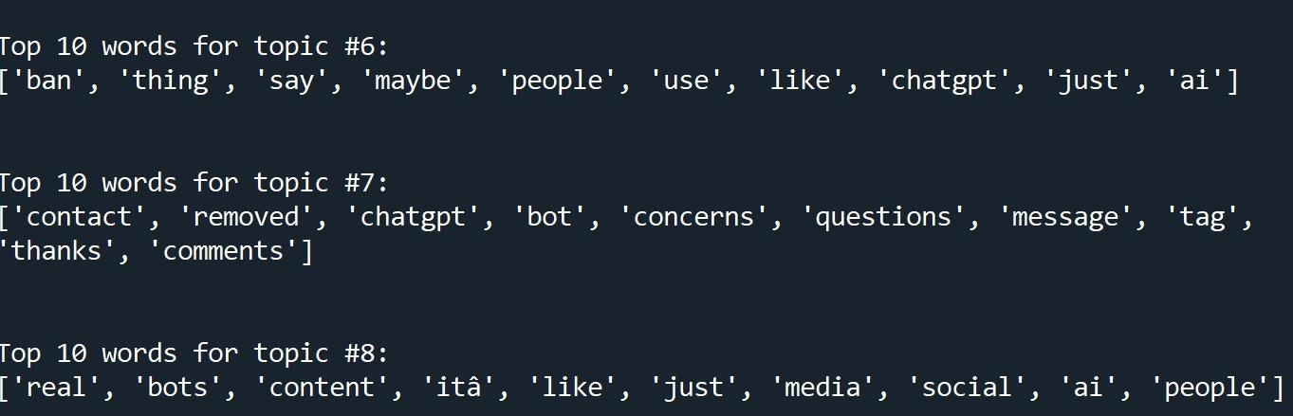
LDA results:

Slide 10
Sentiment Analysis Results:

Slide 11
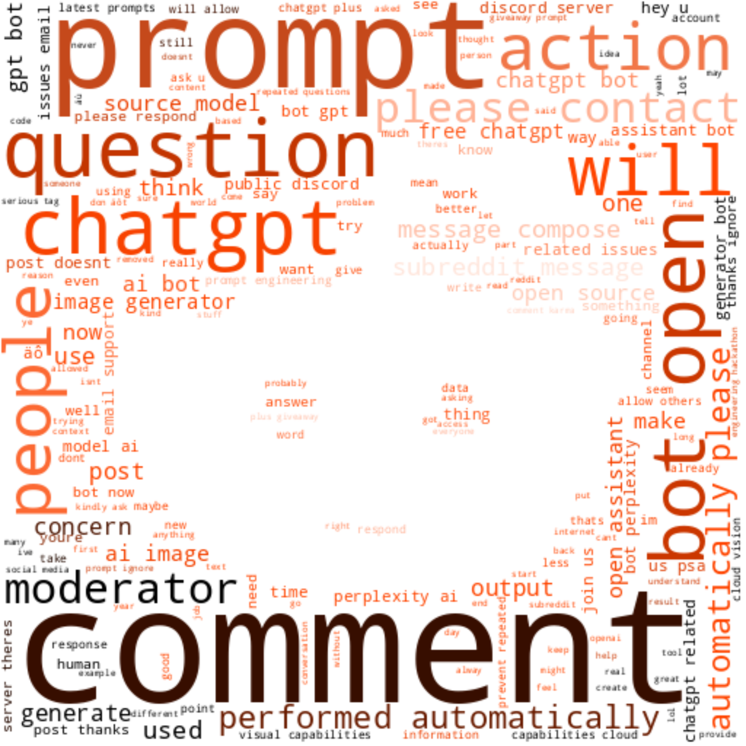
Understanding the Data through Word Cloud:
QUICK TIP
Try right clicking on a photo and using "Replace Image" to show your own photo.

Slide 12
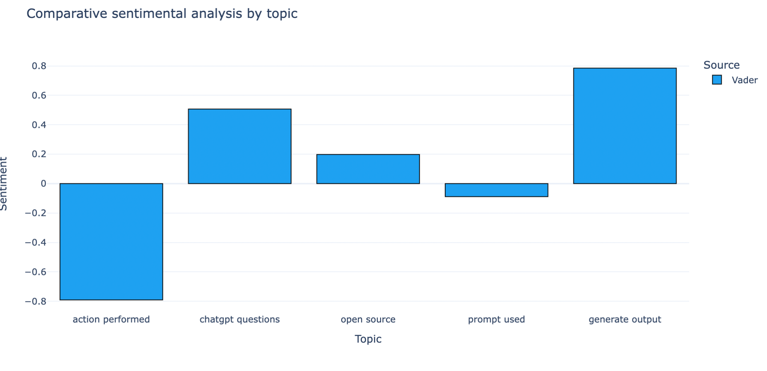
0.78
-0.79
Sentiment

Slide 13
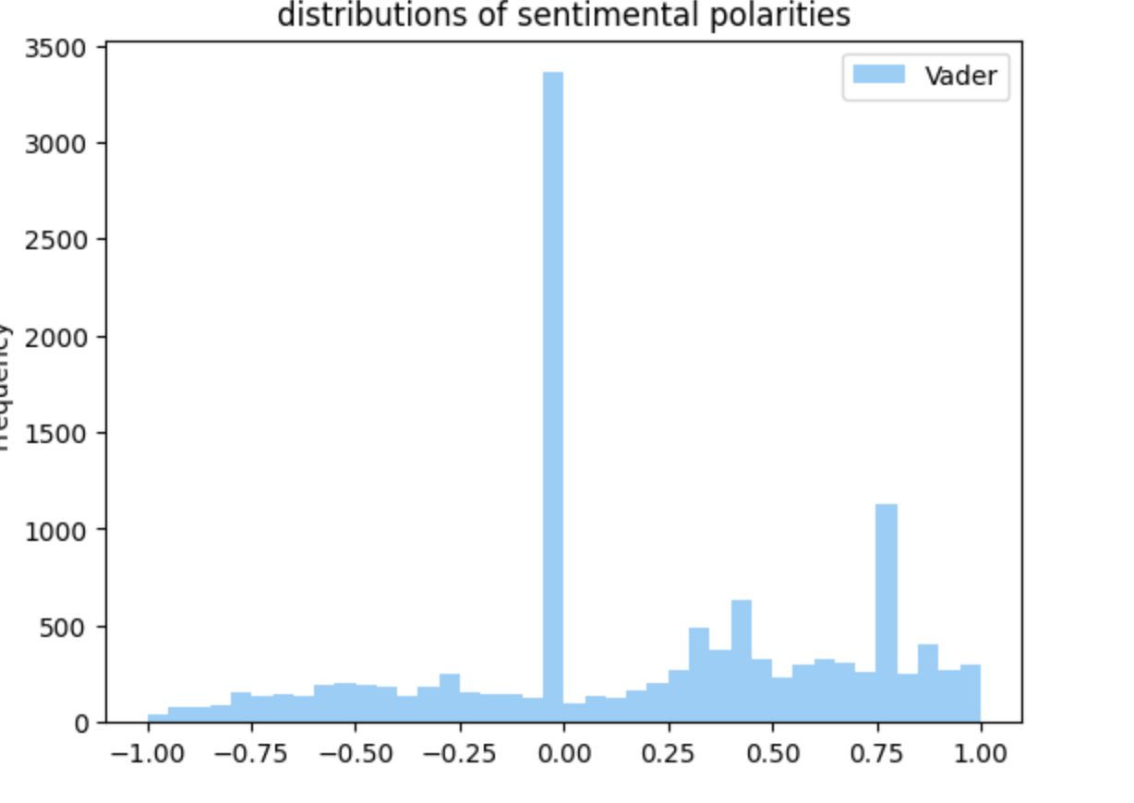
Most of the opinions expressed about ChatGPT appear to be neutral or favorable in tone.
Frequency

Slide 14
Stakeholders :
1. Users: Users of the platform who interact with the chat-GPT and are affected by the quality of its responses. They may become dissatisfied or disengaged if the chat-GPT generates inaccurate or nonsensical responses.
2. Company: The company that operates the platform and provides the chat-GPT service to its users. It may experience a decline in user engagement and satisfaction if the chat-GPT is not able to consistently generate high-quality responses.
3. Customer Support Team: The customer support team may receive more complaints from users if the chat-GPT generates inaccurate or nonsensical responses. They may need to spend more time addressing these complaints and ensuring that users are satisfied with the platform.
4. Developers: The developers who are responsible for building and maintaining the chat-GPT may need to spend more time and resources improving the accuracy and reliability of the system

Slide 15
Possible Actions:
Collect and analyze user feedback to improve the chat-GPT's performance
Improve the quality of training data by adding diverse and representative data, removing low-quality data, and adjusting the weighting of data points
Implement quality checks to identify and filter out inaccurate or nonsensical responses
Provide better documentation and guidelines to help users interact with the chat-GPT more effectively
Regularly update the chat-GPT with the latest models and algorithms to improve its performance over time

Slide 16
References:
1)PRAW : https://praw.readthedocs.io/en/stable/
2)LDA:https://towardsdatascience.com/let-us-extract-some-topics-from-text-data-part-i-latent-dirichlet-allocation-lda-e335ee3e5fa4
3)Data Sources
Twitter : https://twitter.com/
Reddit:https://www.reddit.com/
4)https://bernardmarr.com/chatgpt-what-are-hallucinations-and-why-are-they-a-problem-for-ai-systems/

Slide 17
Thank You

